Slide 1
Software Requirements Engineering
By
Abid Ali
BS Software Engineering
5th
Lecture #6

Slide 2
Agenda
Good practices: Requirements management
Good practices: Knowledge . . . . . . . . . . . . . .
Good practices: Project management . . . .
Getting started with new practices . . . .

Slide 3
Good practices: Requirements management
After you have the initial requirements for a body of work in hand, you must cope with the inevitable changes that customers, managers, marketing, the development team, and others request during development.
Effective change management demands a process for proposing changes, evaluating their potential cost and impact on the project, and making sure that appropriate stakeholders make sensible business decisions about which proposed changes to incorporate.
Well-established configuration management practices are a prerequisite for effective requirements management.
The same version control tools that you use to control your code base can manage your requirements documents.
Even better, store requirements in a requirements management tool, which provides many capabilities to perform these practices.

Slide 4
Cont..
Establish a requirements change control process :
Rather than stifling change or hoping changes don’t happen, accept the fact that they will and establish a mechanism to prevent rampant changes from causing chaos.
Your change process should define how requirements changes are proposed, analyzed, and resolved. Manage all proposed changes through this process.
Defect-tracking tools can support the change control process. Charter a small group of project stakeholders as a change control board (CCB) to evaluate proposed requirements changes, decide which ones to accept, and set implementation priorities or target releases

Slide 5
Cont..
Perform impact analysis on requirements changes:
Impact analysis is an important element of the change process that helps the CCB make informed business decisions.
Evaluate each proposed requirement change to assess the effect it will have on the project. Use the requirements traceability matrix to identify the other requirements, design elements, source code, and tests that you might need to modify.
Identify the tasks required to implement the change and estimate the effort needed to perform those tasks

Slide 6
Cont..
Establish baselines and control versions of requirements sets:
A baseline defines a set of agreed-upon requirements, typically for a specific release or iteration.
After the requirements have been baselined, changes should be made only through the project’s change control process every version of the requirements specification a unique identifier to avoid confusion between drafts and baselines and between previous and current versions

Slide 7
Cont..
Maintain a history of requirements changes:
Retain a history of the changes made to individual requirements.
Sometimes you need to revert to an earlier version of a requirement or want to know how a requirement came to be in its current form.
Record the dates that requirements were changed, the changes that were made, who made each change, and why.
A version control tool or requirements management tool can help with these tasks.

Slide 8
Cont..
Track the status of each requirement:
Establish a repository with one record for each discrete requirement of any type that affects implementation.
Store key attributes about each requirement, including its status (such as proposed, approved, implemented, or verified), so you can monitor the number of requirements in each status category at any time.
Tracking the status of each requirement as it moves through development and system testing provides insight into overall project status

Slide 9
Cont..
Track requirements issues:
When busy people are working on a complex project, it’s easy to lose sight of the many issues that arise, including questions about requirements that need resolution, gaps to eradicate, and issues arising from requirements reviews.
Issue-tracking tools can keep these items from falling through the cracks. Assign a single owner to each issue.
Monitor the status of requirement issues to determine the overall state of the requirements

Slide 10
Cont..
Maintain a requirements traceability matrix:
It’s often valuable—and sometimes required—to assemble a set of links that connect each functional requirement to the design and code elements that implement it and the tests that verify it.
Such a requirements traceability matrix is helpful for confirming that all requirements are implemented and verified.
It’s also useful during maintenance when a requirement has to be modified.
The requirements traceability matrix can also connect functional requirements to the higher-level requirements from which they were derived and to other related requirements.
Populate this matrix during development, not at the end.
Tool support is essential on all but the smallest projects

Slide 11
Cont..
Use a requirements management tool:
Commercial requirements management tools let you store various types of requirements in a database.
Such tools help you implement and automate many of the other requirements management practices described in this section

Slide 12
Good practices: Project management
Software project management approaches are tightly coupled to a project’s requirements processes.
The project manager should base project schedules, resources, and commitments on the requirements that are to be implemented.
An alternative strategy is to timebox development cycles, such that the team estimates the scope of the work they can fit into an iteration of fixed duration.
This is the approach taken by agile development projects. Scope is regarded as negotiable within the schedule.
This transforms scope creep into “scope choice”—the product owner can ask for anything and as much as he wants, but he must prioritize it, and the team quits developing when they run out of time.
Then the team plans a subsequent release for the remaining requirements

Slide 13
Cont..
Select an appropriate software development life cycle:
Your organization should define several development life cycles that are appropriate for various types of projects and different degrees of requirements uncertainty (Boehm and Turner 2004).
Each project manager should select and adapt the life cycle that best suits her project.
Include requirements activities in your life cycle definitions. When possible, specify and implement sets of functionality incrementally so that you can deliver useful software to the customer as early as possible (Larman 2004; Schwaber 2004; Leffingwell 2011

Slide 14
Cont..
Plan requirements approach:
Each project team should plan how it will handle its requirements development and management activities.
An elicitation plan helps ensure that you identify and obtain input from appropriate stakeholders at the right stages of the project using the most appropriate techniques.
The BA and project manager should work together to ensure that tasks and deliverables related to requirements engineering appear in the project management plan

Slide 15
Cont..
Estimate requirements effort:
Stakeholders often want to know how long it’s going to take to develop the requirements for a project and what percentage of their total effort should be devoted to requirements development and management.
Naturally, this depends on many factors. Consider the factors that would indicate that you should spend either more or less time than average to ensure the requirements lay a solid foundation for development (Wiegers 2006).

Slide 16
Cont..
Base project plans on requirements:
Develop plans and schedules for your project iteratively as the scope and detailed requirements become clear.
Begin by estimating the effort needed to develop the user requirements from the initial product vision and project scope.
Early cost and schedule estimates based on fuzzy requirements will be highly uncertain, but you can improve the estimates as your understanding of the requirements improves.
On agile projects, the timeboxed nature of iterations means that planning involves adjusting the scope to fit within the fixed schedule and resource constraints.

Slide 17
Cont..
Identify requirements decision makers:
Software development involves making many decisions.
Conflicting user inputs must be resolved, commercial package components must be selected, change requests must be evaluated, and on and on.
Because so many decisions involve requirements issues, it’s essential for the project team to identify and empower its requirements decision makers, preferably before they confront their first significant decision

Slide 18
Cont..
Renegotiate project commitments when requirements change:
A project team makes commitments to deliver specific sets of requirements within a particular schedule and budget.
As you incorporate new requirements into the project, evaluate whether you can still achieve the current commitments with the available resources.
If not, communicate the project realities to management and negotiate new, realistically achievable commitments (Wiegers 2007; Fisher, Ury, and Patton 2011).
You might also need to renegotiate commitments as requirements evolve from their fuzzy beginnings with initial implementation estimates to clear, validated requirements

Slide 19
Cont..
Analyze, document, and manage requirements-related risks:
Unanticipated events and conditions can wreak havoc on an unprepared project.
Identify and document risks related to requirements as part of the project’s risk-management activities.
Brainstorm approaches to mitigate or prevent these risks, implement the mitigation actions, and track their progress and effectiveness.

Slide 20
Cont..
Track the effort spent on requirements:
To improve your ability to estimate the resources needed for requirements work on future projects, record the effort your team expends on requirements development and management activities (Wiegers 2006).
Monitor the effect that your requirements activities have on the project to help judge the return on your investment in requirements engineering

Slide 21
Cont..
Review lessons learned regarding requirements on other projects:
A learning organization conducts periodic retrospectives to collect lessons learned from completed projects or from earlier iterations of the current project (Kerth 2001; Derby and Larsen 2006; Wiegers 2007).
Studying the lessons learned from previous requirements experiences can help project managers and business analysts steer a more confident course in the future.

Slide 22
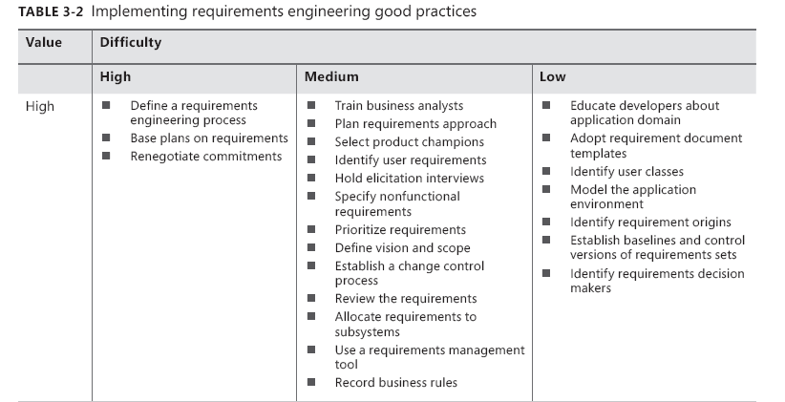
Getting Started With New Practices

Slide 23
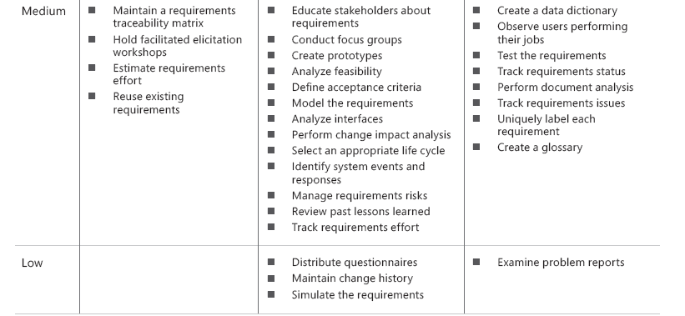
Cont..

